Slide 1
Analysis of GameStop stock within WallStreetBets

Slide 2

Thesis
The GameStop stock price was directly affected by the Subreddit WallstreetBets

Slide 3
Background and EDA
I implemented a web scraper using the Reddit PushShift API
I scraped subreddit post information for all of 2021 (when GME became relevant) and stored in Postgres
I counted the number of posts per day containing the $GME symbol
I cross listed this with GME daily stock price

Slide 4

Software Design
Wanted program to be scalable to other “hype” stocks for comparison
Designed executable program with user input and error handling
For given stocks inputted, program will query from database
Finally producing relevant plots and statistics

Slide 5
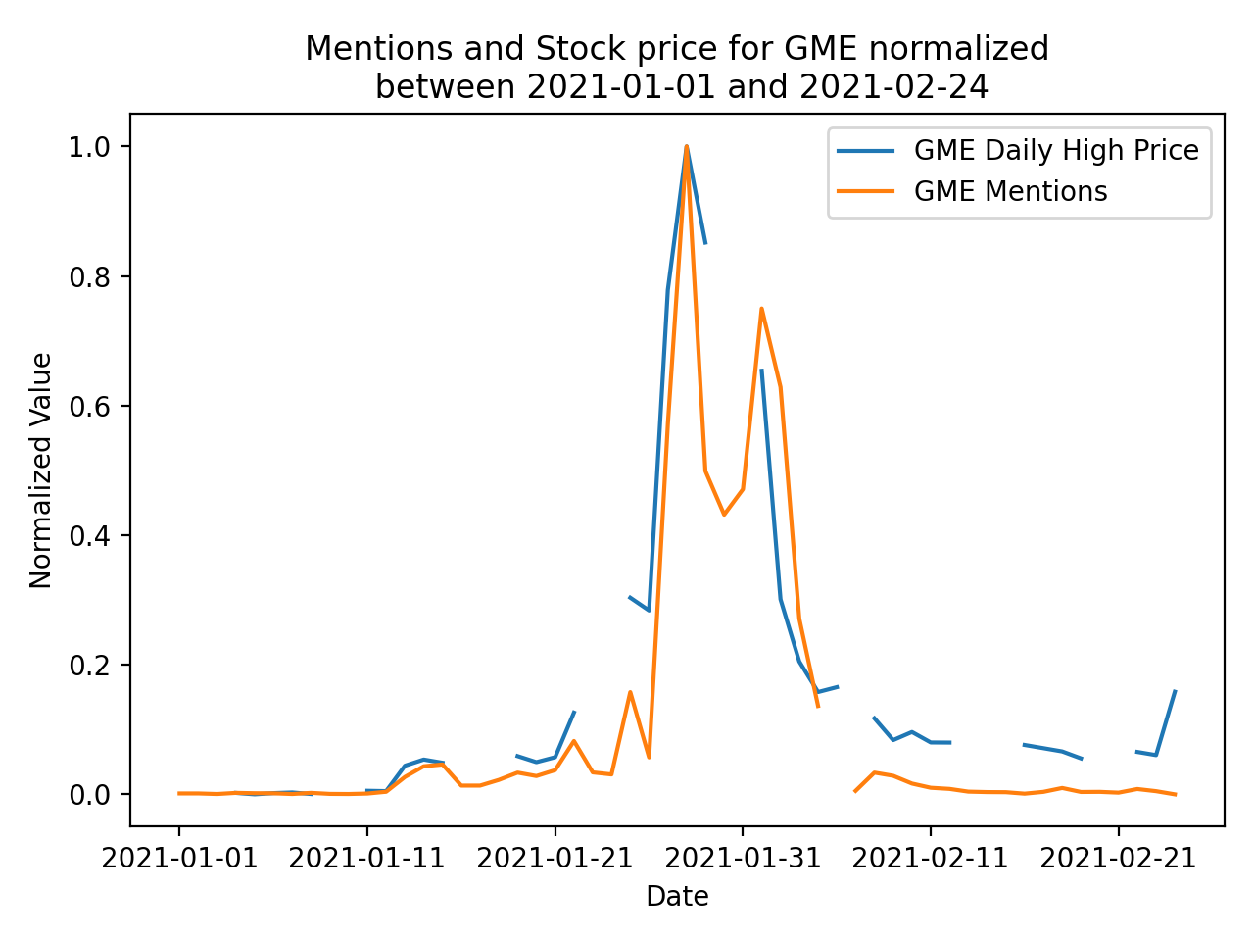
Findings
Visual inspection shows direct correlation between the value of GameStop stock and the frequency of post mentions on WallStreetBets
When GME was at its highest in late January, the number of daily mentions skyrocketed
However this does not necessarily suggest which one influenced the other

Slide 6
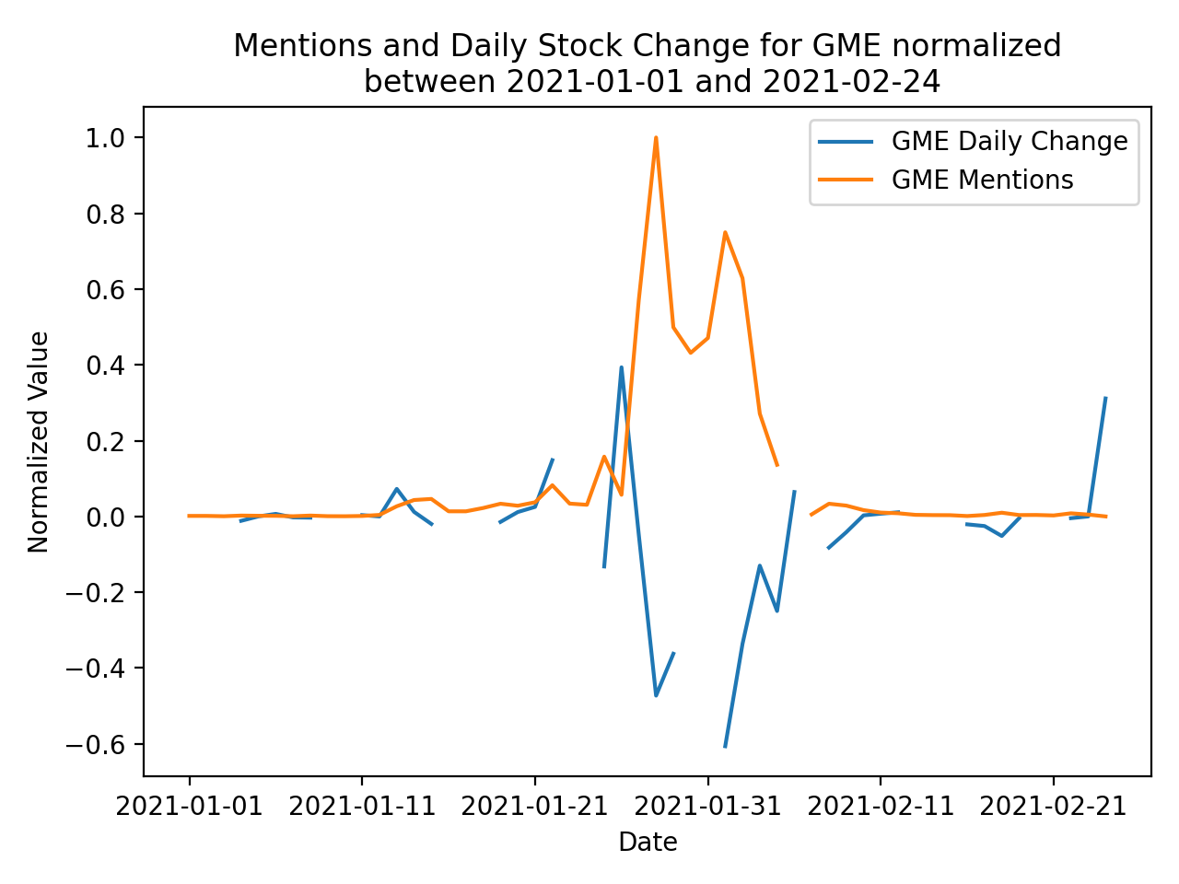
Findings
The daily price change compared to GME mentions suggests that number of mentions will be highest on days of greatest price change
Where this is independent whether the price change is positive or negative

Slide 7
Hypothesis Testing
Null Hypothesis: No correlation between number of stock mentions and GameStop stock price per day
Alternate Hypothesis: Statistically significant correlation between stock mentions and GameStop stock price per day

Slide 8
Statistical Tests
One Sample t test to analyze correlation between two datasets
Took normalized gradients for daily mentions and stock price
Weighted same direction gradient with ‘1’ and differing direction gradients as ‘0’
Ran t test with mu = 0.5
Results showed significant correlation between two gradient values
P value = 0.00019
Using a standard alpha threshold = 0.05, we can confidently reject the Null Hypothesis
This is expected as frome visual inspection it was clear that change in daily stock price directly correlated to daily number of mentions

Slide 9
Next steps
Find another quantitative measure to compare WallStreetBets to stock price
Although taking the daily gradient for stock prices and number of mentions would be more independently distributed than the daily value, it is still comparing side by side time series data which is unlikely to be truly independent
Time series data is continuously changing
Write a script to scrape and update database nightly for most up to date data
Deploy as program as Full Stack web application

